Slide 1
About Me
Ritesh Singh
Sun Certified java Professional
Oracle Certified Database Administrator
Certified Ethical Hacker
Certified EC-Council Instructor (CEI)

Slide 2
Course Overview
What is an Activity Diagram?
Components of Activity Diagram
Why use Activity Diagrams?
Activity Diagram Notations
How to draw an activity diagram?
Example of Activity Diagram
When Use Activity Diagram

Slide 3
What is an Activity Diagram?
Activity diagram is defined as a UML diagram that focuses on the execution and flow of the behavior of a system instead of implementation. It is also called object-oriented flowchart. Activity diagrams consist of activities that are made up of actions which apply to behavioral modeling technology.

Slide 4
Components of Activity Diagram
Activities:
It is a behavior that is divided into one or more actions. Activities are a network of nodes connected by edges. There can be action nodes, control nodes, or object nodes. Action nodes represent some action. Control nodes represent the control flow of an activity. Object nodes are used to describe objects used inside an activity. Edges are used to show a path or a flow of execution. Activities start at an initial node and terminate at a final node.

Slide 5
Activity partition/swimlane
An activity partition or a swimlane is a high-level grouping of a set of related actions. A single partition can refer to many things, such as classes, use cases, components, or interfaces.
If a partition cannot be shown clearly, then the name of a partition is written on top of the name of an activity.

Slide 6
Fork and Join nodes
Using a fork and join nodes, concurrent flows within an activity can be generated. A fork node has one incoming edge and numerous outgoing edges. It is similar to one too many decision parameters. When data arrives at an incoming edge, it is duplicated and split across numerous outgoing edges simultaneously. A single incoming flow is divided into multiple parallel flows.
A join node is opposite of a fork node as It has many incoming edges and a single outgoing edge. It performs logical AND operation on all the incoming edges. This helps you to synchronize the input flow across a single output edge.

Slide 7
Pins
An activity diagram that has a lot of flows gets very complicated and messy.
Pins are used to clearing up the things. It provides a way to manage the execution flow of activity by sorting all the flows and cleaning up messy thins. It is an object node that represents one input to or an output from an action.
Both input and output pins have precisely one edge.

Slide 8
Why use Activity Diagrams?
Activity diagram allows you to create an event as an activity which contains a collection of nodes joined by edges. An activity can be attached to any modeling element to model its behavior. Activity diagrams are used to model,
Use cases
Classes
Interfaces
Components
Collaborations

Slide 9
An example of a Activity diagrams
Activity diagrams are used to model processes and workflows. The essence of a useful activity diagram is focused on communicating a specific aspect of a system's dynamic behavior. Activity diagrams capture the dynamic elements of a system.
Activity diagram is similar to a flowchart that visualizes flow from one activity to another activity. Activity diagram is identical to the flowchart, but it is not a flowchart. The flow of activity can be controlled using various control elements in the UML diagram. In simple words, an activity diagram is used to activity diagrams that describe the flow of execution between multiple activities.

Slide 10
Activity Diagram Notations
Activity diagrams symbol can be generated by using the following notations:
Initial states: The starting stage before an activity takes place is depicted as the initial state
Final states: The state which the system reaches when a specific process ends is known as a Final State
State or an activity box:
Decision box: It is a diamond shape box which represents a decision with alternate paths. It represents the flow of control.

Slide 11
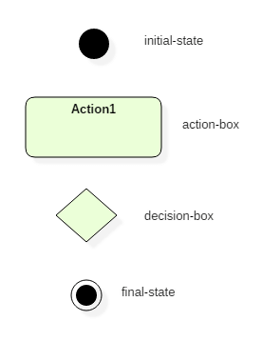
Activity Diagram Notations

Slide 12
Following rules must be followed while developing an activity diagram
All activities in the system should be named.
Activity names should be meaningful.
Constraints must be identified.
Activity associations must be known.

Slide 13
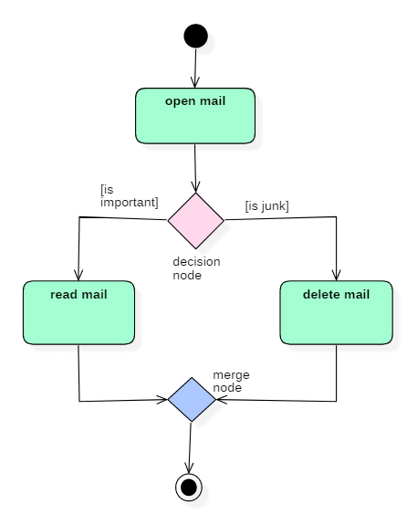
Example of Activity Diagram

Slide 14
Example of Activity Diagram continue …
In the above activity diagram, three activities are specified. When the mail checking process begins user checks if mail is important or junk. Two guard conditions [is essential] and [is junk] decides the flow of execution of a process. After performing the activity, finally, the process is terminated at termination node.

Slide 15
When Use Activity Diagram
Activity diagram is used to model business processes and workflows. These diagrams are used in software modeling as well as business modeling.
Most commonly activity diagrams are used to,
Model the workflow in a graphical way, which is easily understandable.
Model the execution flow between various entities of a system.
Model the detailed information about any function or an algorithm which is used inside the system.
Model business processes and their workflows.
Capture the dynamic behavior of a system.
Generate high-level flowcharts to represent the workflow of any application.
Model high-level view of an object-oriented or a distributed system.

Slide 16
Summary
Activity diagram is also called as object-oriented flowcharts.
Activity diagrams consist of activities that are made up of smaller actions.
Activity is a behavior that is divided into one or more actions.
It uses action nodes, control nodes and object nodes.
An activity partition or a swimlane is a high-level grouping of a set of related actions.
Fork and join nodes are used to generate concurrent flows within an activity.
Activity diagram is used to model business processes and workflows.

Slide 17
Thank You

